Slide 1
Modelling

Slide 2
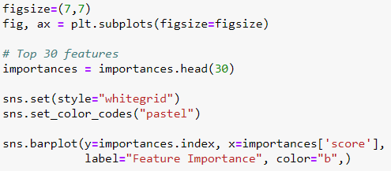
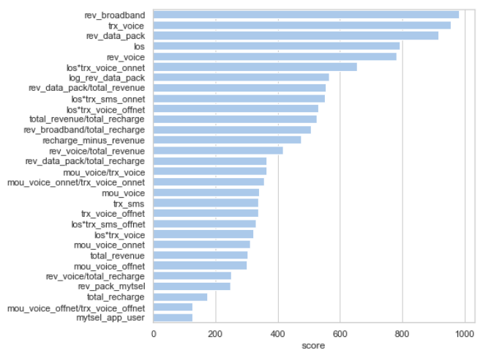
Feature Selection

Slide 3
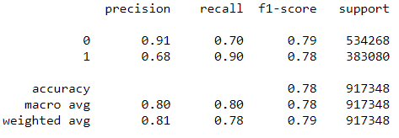
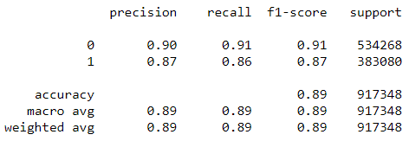
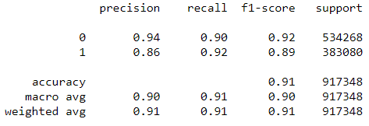
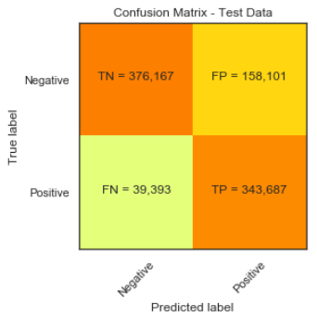
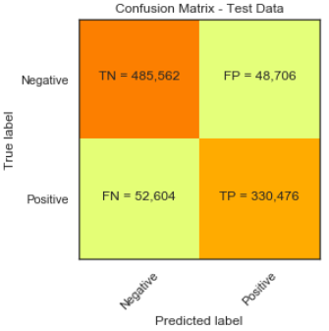
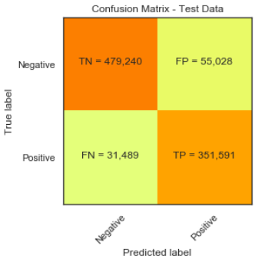
Model Selection
Logistic Regression
Decision Tree
Random Forest

Slide 4
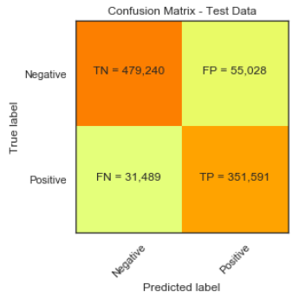
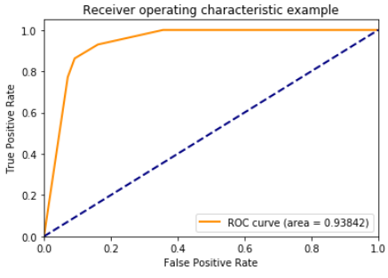
Model Evaluation (Random Forest)

Slide 5
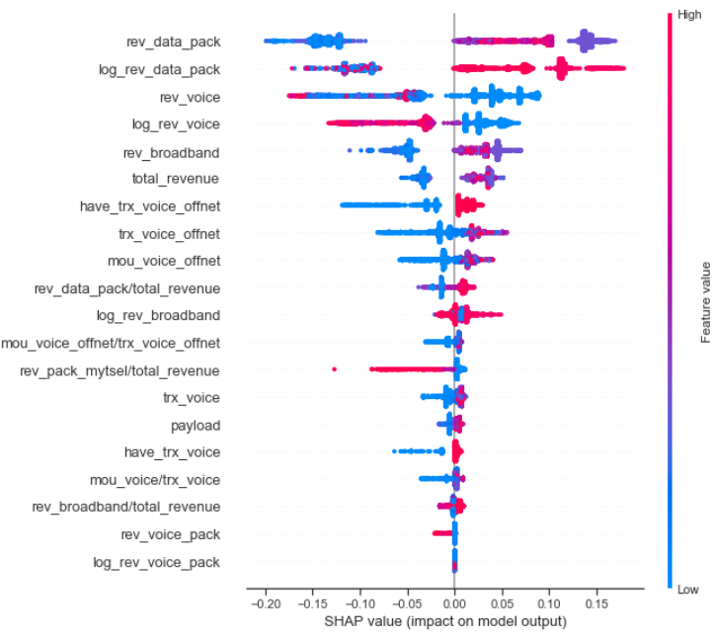
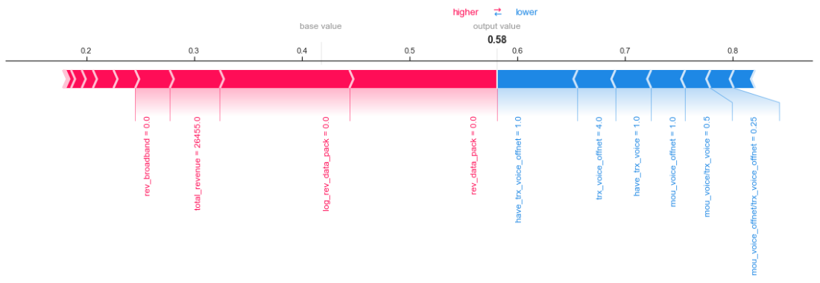
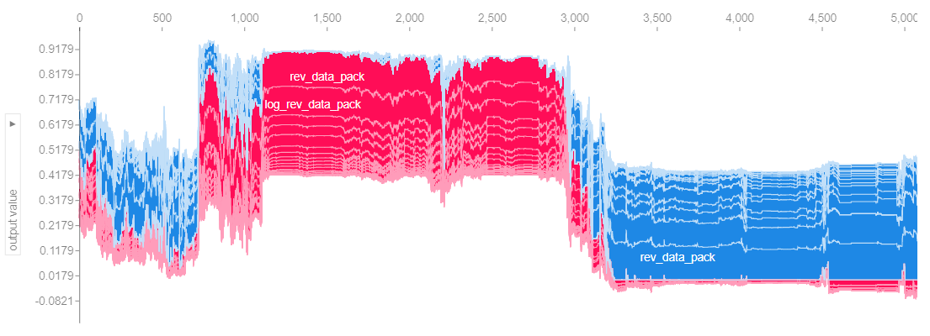
Shap Value
Visualization performed using 5.000 data samples

Slide 6
Clustering

Slide 7
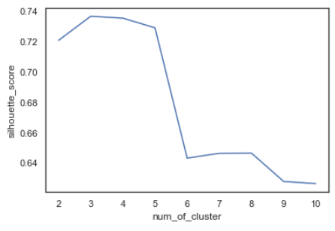
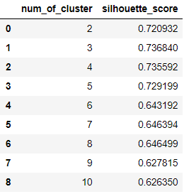
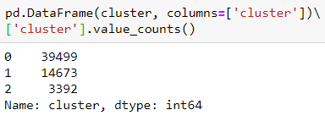
Choosing Suitable Number of Cluster
We use silhouette_score to determine the suitable number of cluster (3 cluster).
Total msisdn in each cluster

Slide 8
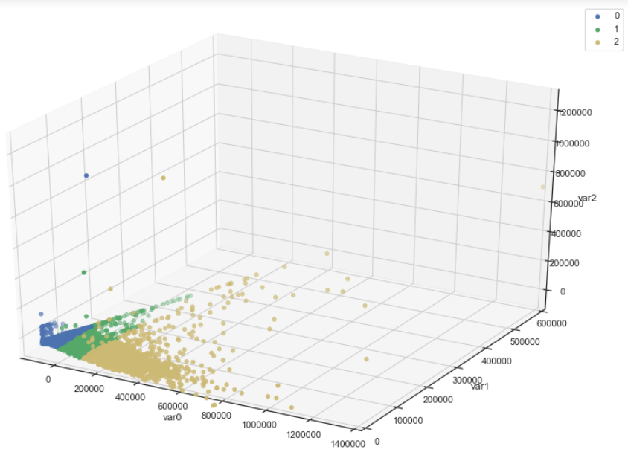
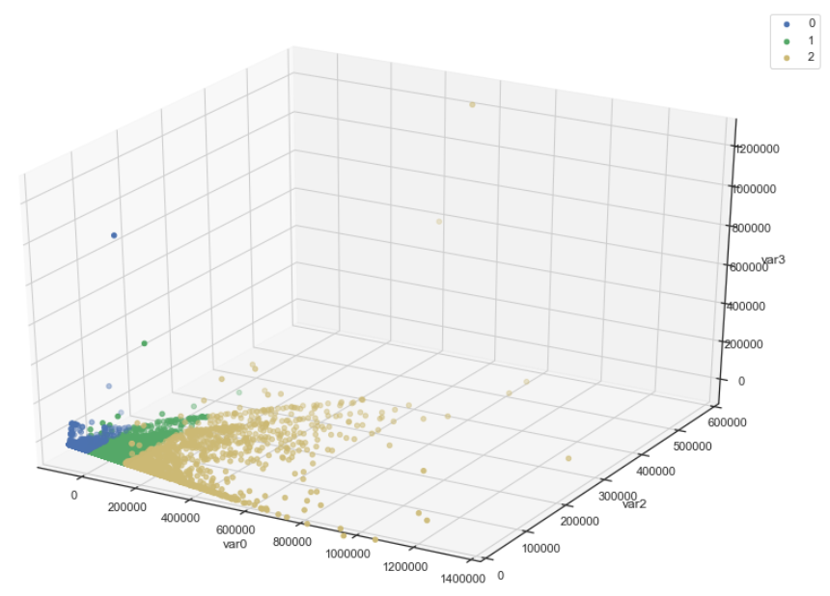
Cluster Visualization Using PCA
Feature 1, 2 & 3
Feature 1, 2 & 4

Slide 9
Cluster Summary

Slide 10
Sub-Cluster By ARPU

Slide 11

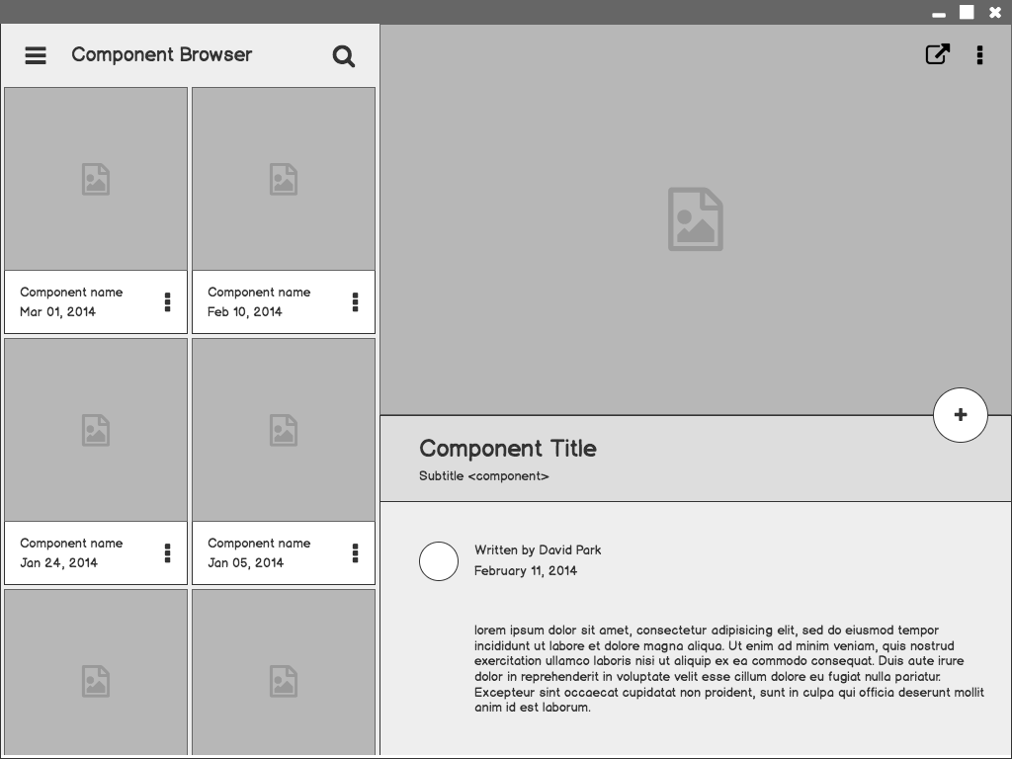

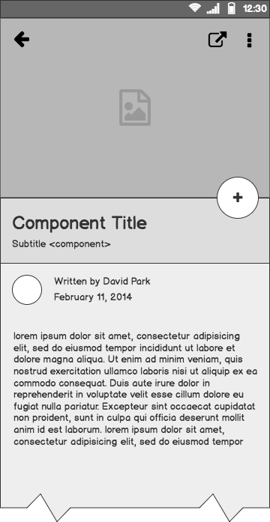
Project Wireframes
Problem statement and
solution proposal

Slide 12
Outline
The Problem
Solution Proposal
Wireframes
Next Steps

Slide 13
The Problem

Slide 14
Problem statement
State the problem you are solving in one or two sentences.
Make sure to explain why it is a real problem.

Slide 15
What customers do today
Justify your effort to try to solve the problem.
Highlight the pain points of the current solution or how customers deal with not having a solution to the problem.

Slide 16
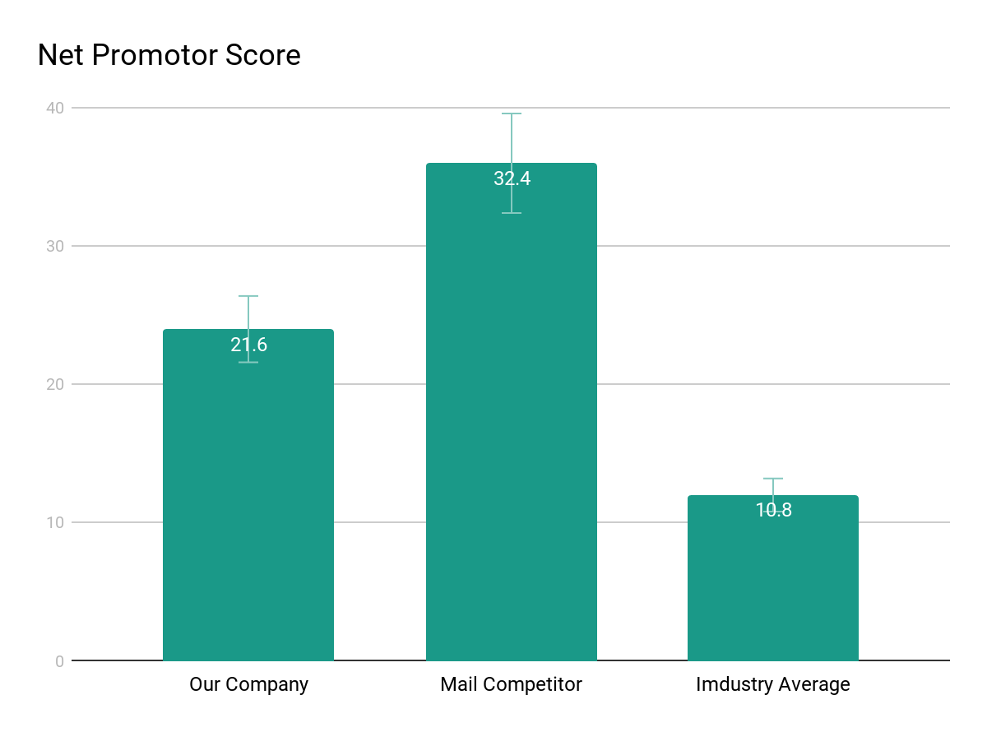
Supporting information
01
1
List any research or data you have to support the need for a solution.

Slide 17
Supporting information
02
82%
Users are constantly searching for a solution
Explain why you’re focusing on a particular part of the problem or a particular subset of users.

Slide 18

Supporting information
03
Julia
Team Manager
Reference your personas, if you have them.
Describe the content of Julia’s job and the problem she and her team are currently facing.

Slide 19
Use cases / user stories
Use cases, user stories, notes to set up the wireframes. Such as…
“As an Administrator, I would like to restrict permissions based on role.”
“As a Moderator, I would like to flag and approve comments.”
Executives indicated that being able to see a summary of each segment of data was their #1 priority.
Note: secondary admin workflow not planned for this release.

Slide 20
Assumptions
State your assumptions or any unknowns here.

Slide 21
Solution Proposal

Slide 22
Solution description
Now that you’ve justified your attention to the problem, summarize your solution in one or two sentences.

Slide 23
Why it’s better than existing solutions
Return to the problem now that you’ve introduced your solution. Compare your solution to others and describe how it is superior.

Slide 24
Wireframes

Slide 25
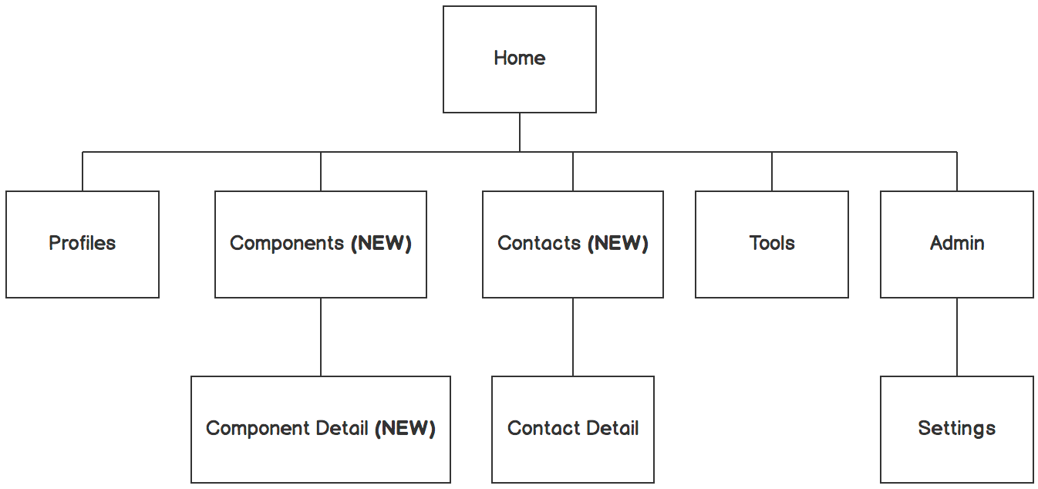

Information architecture
Balsamiq Tip | Information architecture is the flow of content across the site or application (more info).

Slide 26
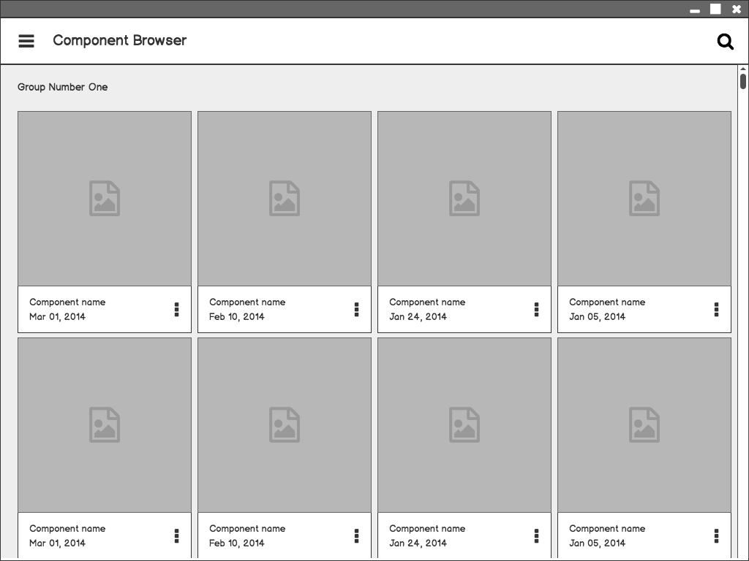
Component Browser
Call out key parts of the UI
Balsamiq Tip | Use the Balsamiq add-on to make your own wireframe.

Slide 27
Component Detail

Slide 28
Component Detail (Mobile)
Articulate your design decisions by adding justifications

Slide 29
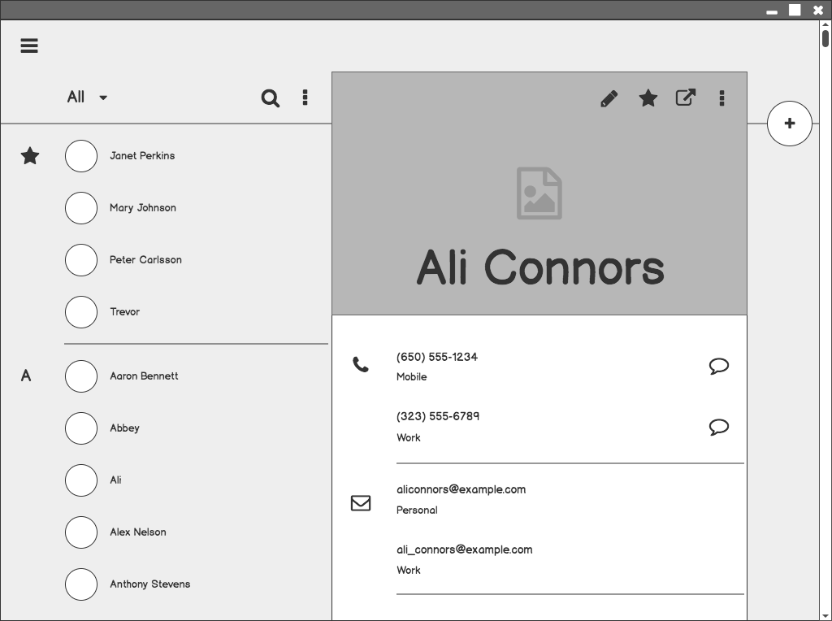
Contacts

Slide 30
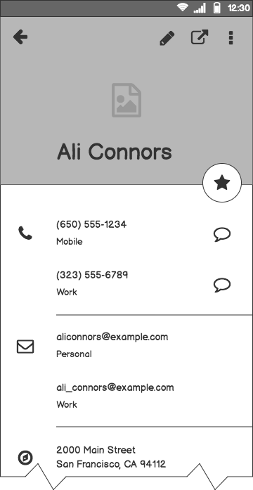
Contacts (Mobile)

Slide 31
Next Steps

Slide 32
What next?
Present the timeline.
Solicit comments on these slides or reviews on these wireframes in the Balsamiq add-on.
User testing plan.

Slide 33
Timeline
MAY
JUN
TODAY
AUG
SEPT
OCT
NOV
Requirements gathering
User research
Wireframes
Review
Prototype
User testing
Dev hand-off

Slide 34
Questions?

Slide 35
References
Tips for Presenting Your Wireframes
3 Steps to Better UI Wireframes
Wireframing for Beginners

